Slide 1
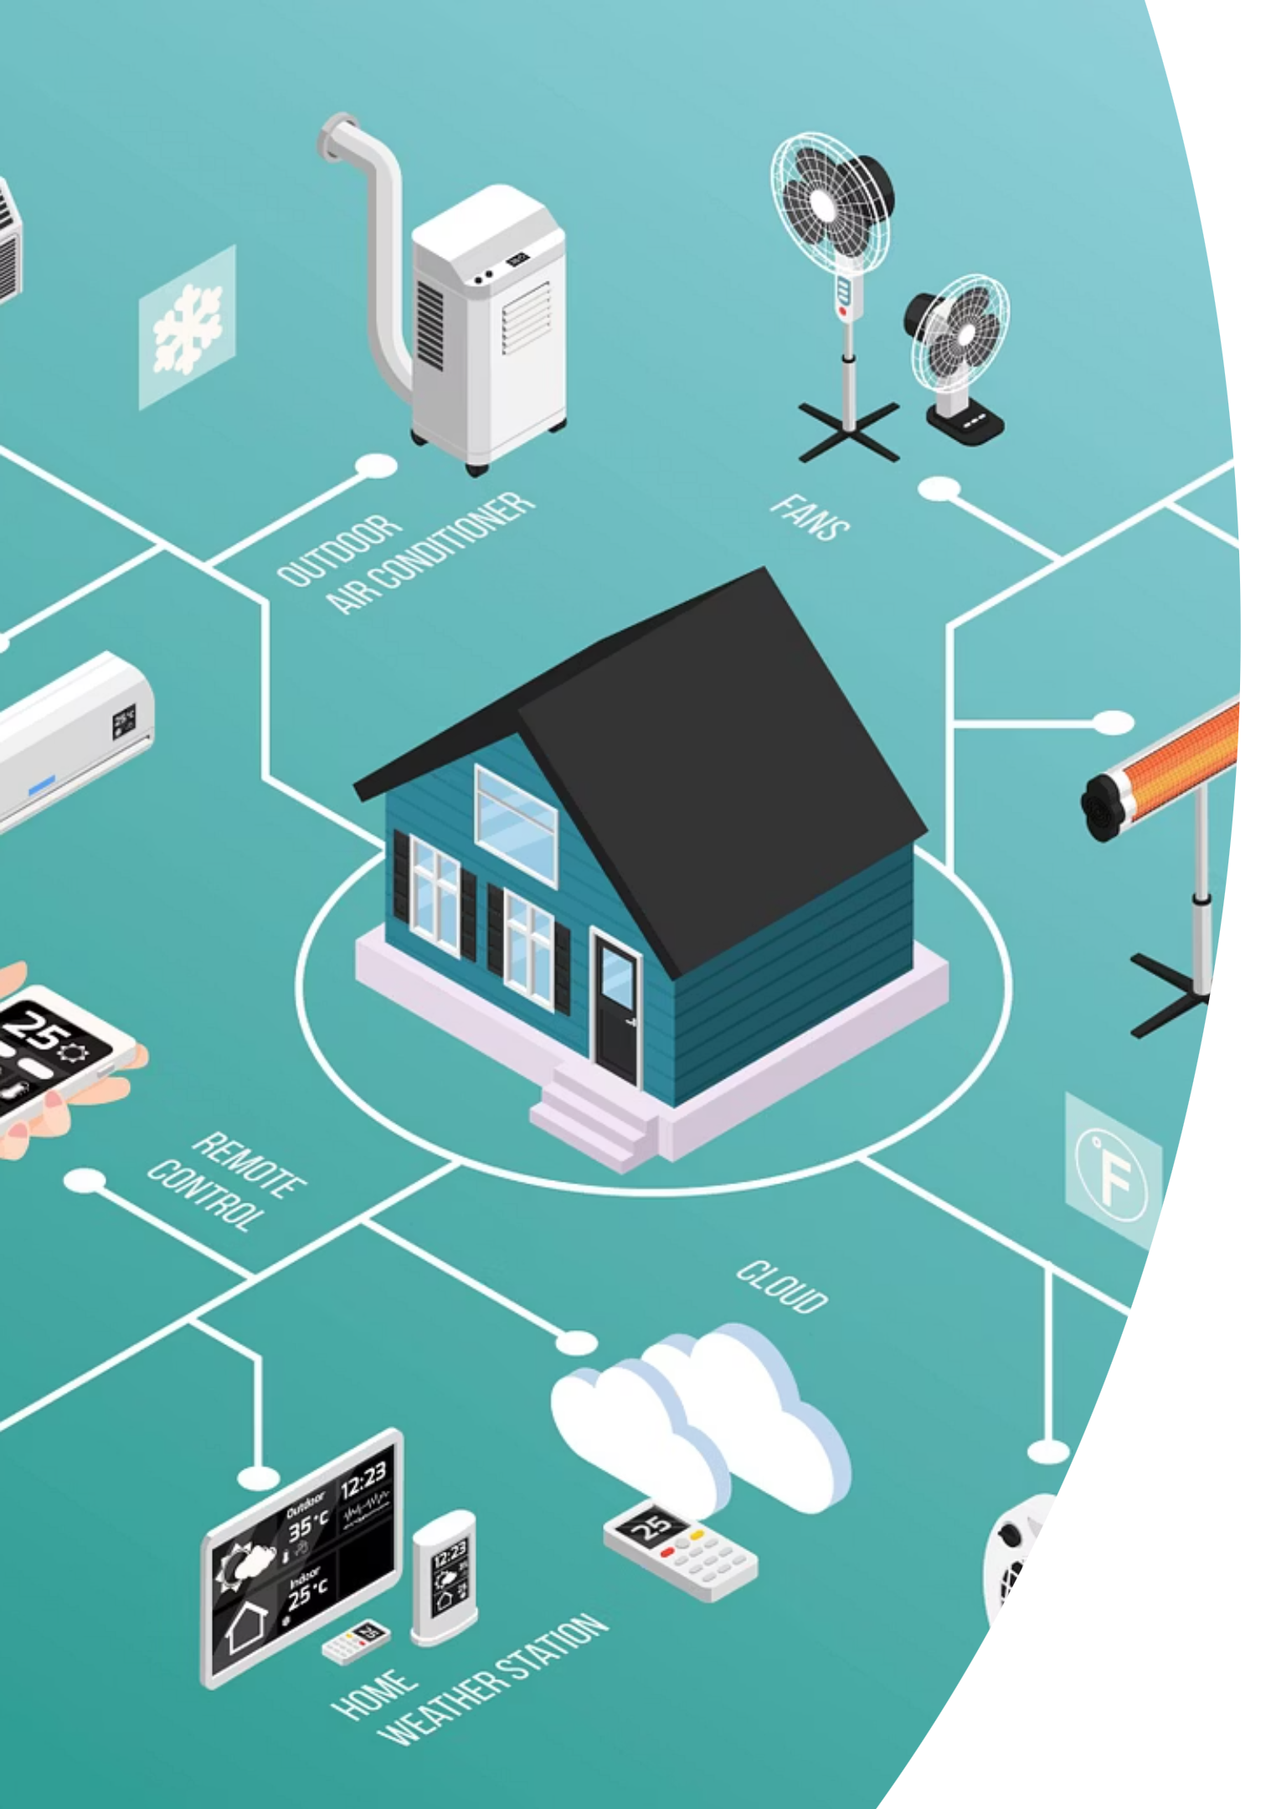
Final Project: Securing MQTT Communication in Smart Home IoT Systems
CEN455: CEN455: Fund. of Sec. for Computer & Embedded Systems
Instructor: Dr. Mohammed Fadhul Idris
Student Name & ID: Aliya Haider- 1082079

Slide 2
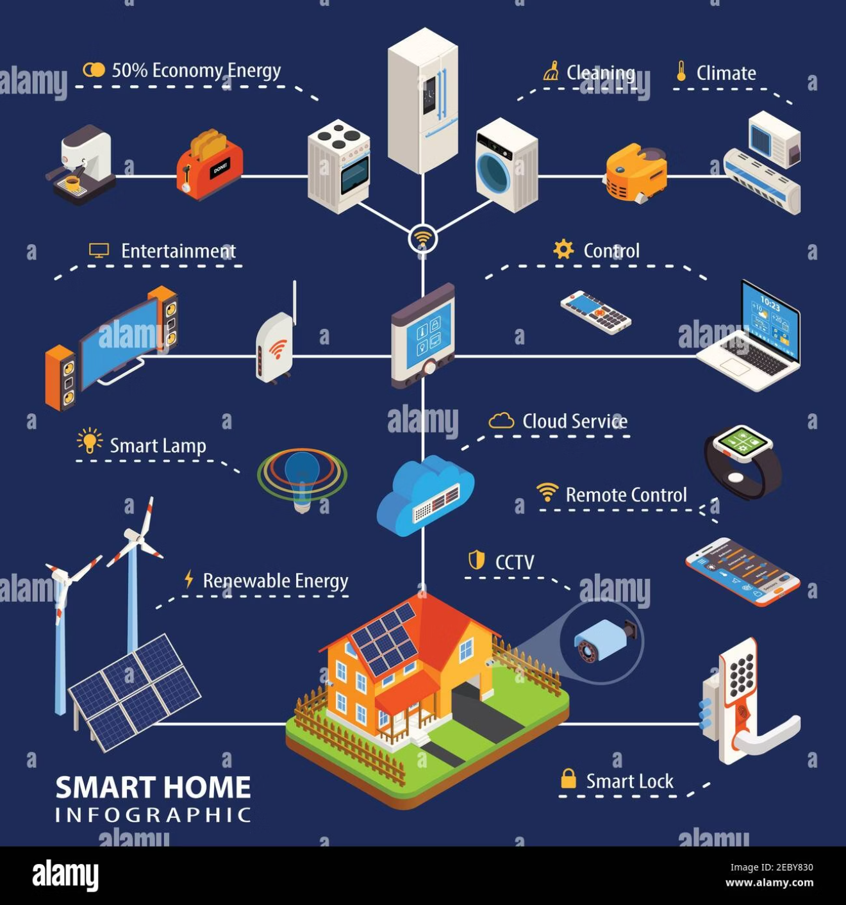
The Peril of Default MQTT: A Smart Home Vulnerability
Unsecured MQTT, a common protocol in IoT, exposes smart home devices to significant risks.
The default MQTT implementation is inherently vulnerable:
Data transmitted in plaintext, easily intercepted.
Lack of authentication allows unauthorised access.
Susceptible to eavesdropping, spoofing, tampering, and replay attacks.
Confidentiality and integrity are paramount for smart home security.

Slide 3

Insecure System Architecture: An Open Door for Attackers
Without security measures, data flows unprotected, creating numerous attack vectors.
Actuator
Sensor
Receives unverified commands
Publishes plaintext messages
Insecure MQTT Data Flow
Attacker
MQTT Broker
Can subscribe & inject freely
Forwards messages without encryption
Key characteristics of an insecure MQTT system:
Messages are transmitted in easily readable plaintext.
Absence of digital signatures for message authenticity.
No mechanisms to verify data integrity or prevent replay attacks.
Attackers can effortlessly subscribe to topics and inject malicious data.

Slide 4

The Critical Flaws: Attacks on Insecure Systems
The absence of cryptographic protection leaves systems wide open to exploitation.
Eavesdropping
Message Injection
Sensitive data, like home automation commands, can be intercepted and read.
Malicious commands can be injected, leading to unauthorised device control.
Replay Attacks
Tampering
Previously captured valid messages can be retransmitted to trigger unintended actions.
Messages can be altered mid-transmission, corrupting data or changing commands.
All these attacks succeed due to the complete lack of cryptography.

Slide 5
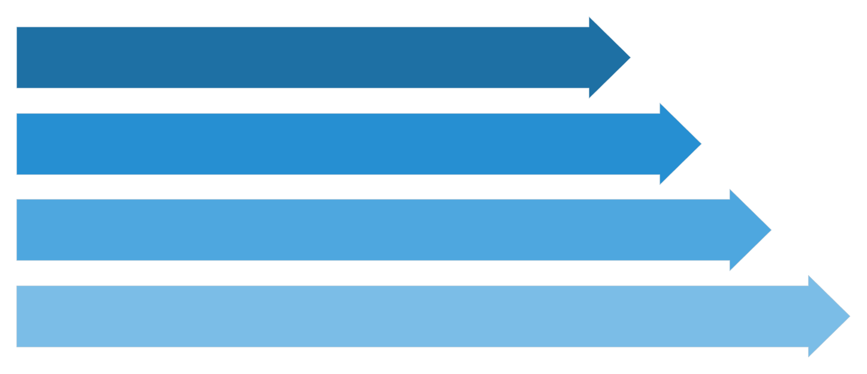
A Robust Defence: Secure Architecture Overview
Implementing robust encryption and authentication protocols transforms MQTT into a secure communication channel.
Sensor Secure
Encrypted Payload
MQTT Broker
Actuator Secure
Key protections in the secure system:
AES-256-GCM encryption ensures data confidentiality and integrity.
RSA-2048 facilitates secure key exchange between devices.
DSA signatures verify message authenticity and origin.
Counter-based replay protection prevents malicious retransmission of messages.
Broker Access Control Lists (ACLs) enforce strict authorisation policies.

Slide 6

Understanding Secure Message Flow
Each component plays a vital role in encrypting, transmitting, and verifying data integrity.
01
Sensor Encrypts & Signs
The smart home sensor encrypts the payload using AES-256-GCM and adds a DSA signature, nonce, and authentication tag. It also includes an encrypted session key.
02
Broker Forwards Encrypted Payload
The MQTT broker receives and transparently passes the encrypted payload without decryption, maintaining end-to-end security.
03
Actuator Verifies Signature
Upon receiving the payload, the smart home actuator first verifies the DSA signature to confirm message authenticity.
04
Actuator Decrypts & Checks Counter
The actuator then decrypts the payload and checks the counter for replay protection, ensuring the message is fresh and valid.

Slide 7
Attacks on the Secure System: Complete Blockage
With robust cryptographic controls, all previously successful attacks are neutralised.
Eavesdropping
Message Injection
Blocked: Data is encrypted (AES-256-GCM), rendering intercepted information unreadable.
Blocked: DSA signatures and ACLs prevent unauthorised command injection.
Replay Attacks
Tampering
Blocked: Counter-based protection detects and rejects replayed messages.
Blocked: Message integrity is ensured by AES-256-GCM authentication tags and DSA signatures.
Our secure system successfully rejected over 270 malicious packets, resulting in zero successful attacks.

Slide 8
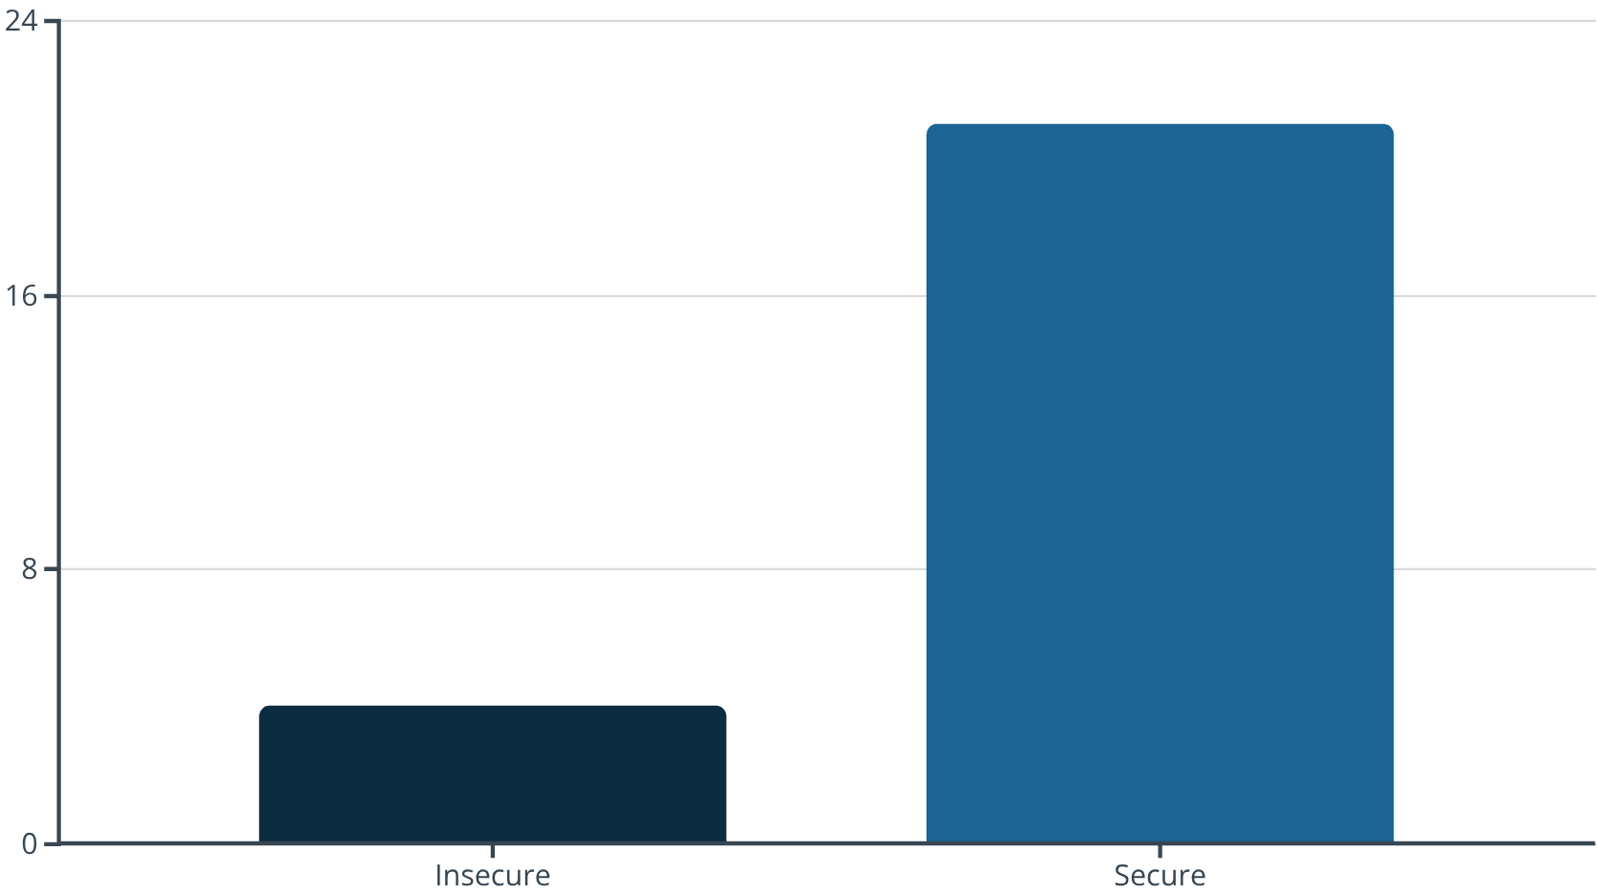
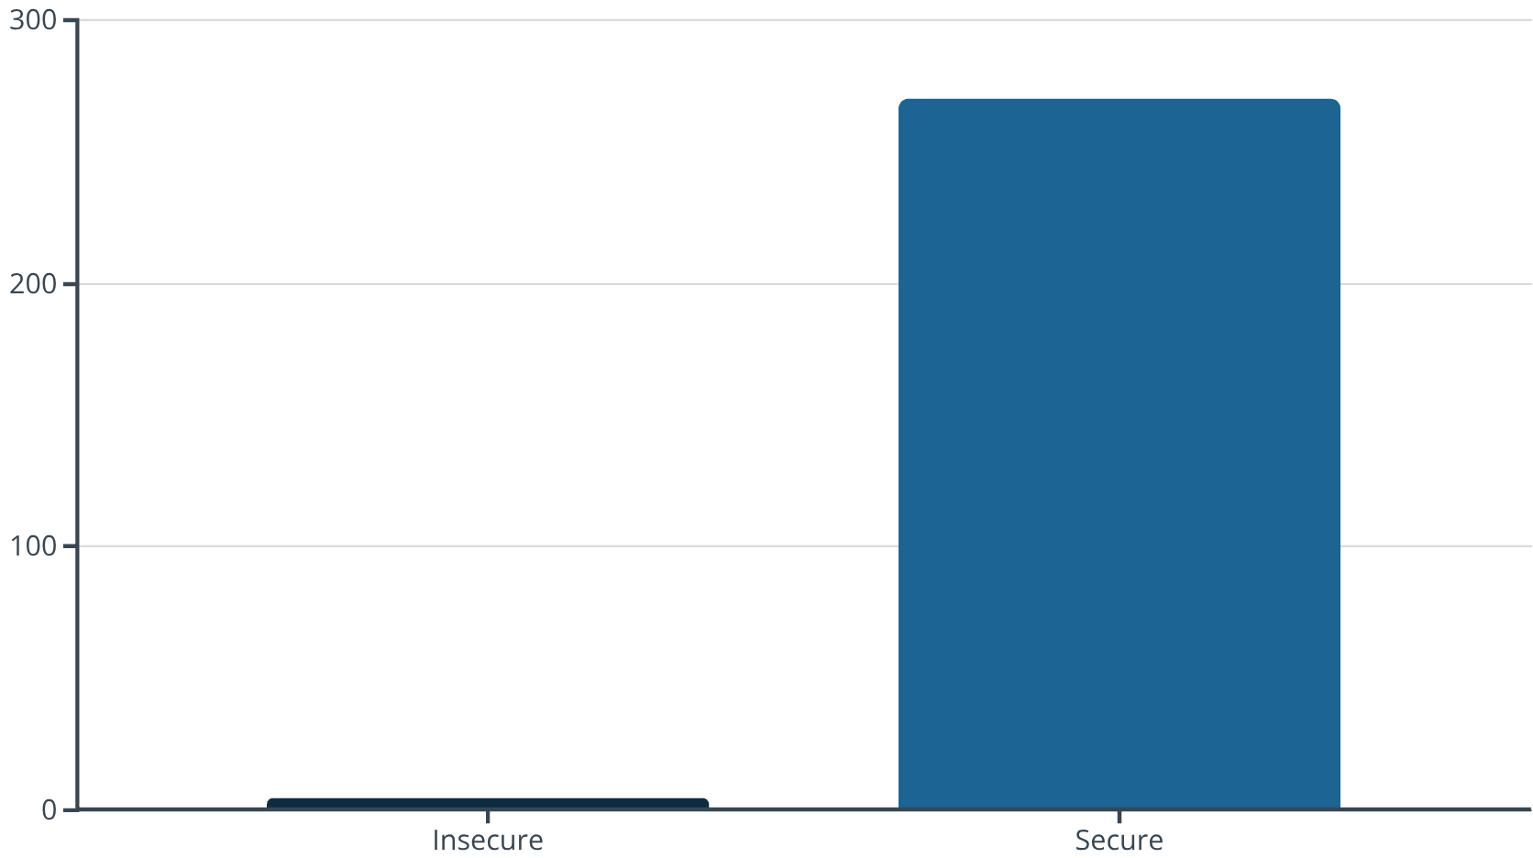
Quantitative Results: Performance vs. Security
While security adds a minimal overhead, the enhanced protection is invaluable.
Latency Comparison: Secure communication introduces a slight increase in latency (~21 ms) compared to the insecure system (~4 ms). This overhead is well within acceptable limits for most IoT applications, especially in smart homes.
Attack Attempts vs. Blocks: The insecure system blocked zero attacks, while the secure system successfully rejected over 270 malicious attempts. This demonstrates a substantial improvement in overall security posture.

Slide 9
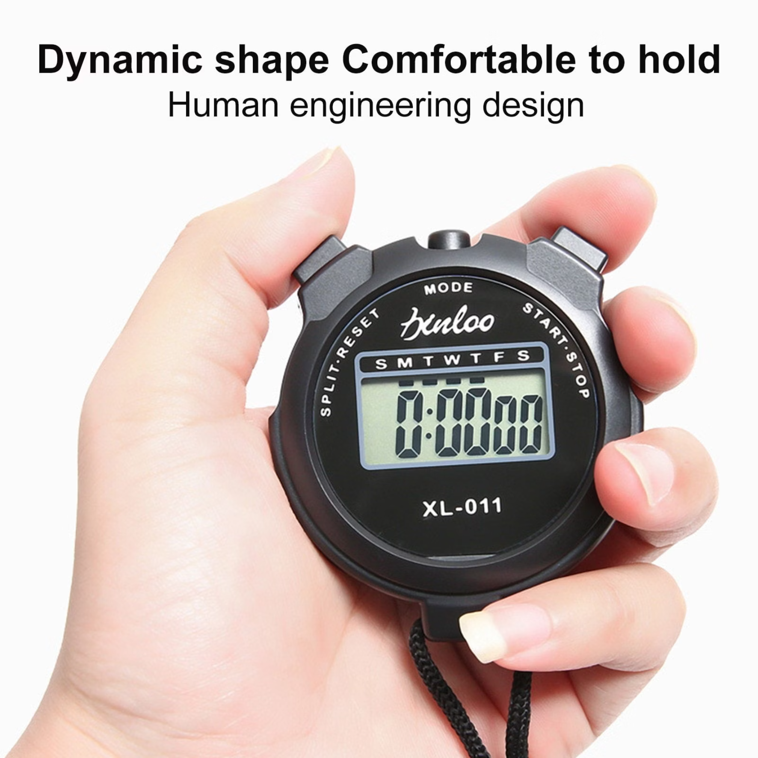

Mitigating Timing Attacks: Constant-Time Operations
Eliminating timing leaks is crucial for cryptographic integrity, preventing side-channel attacks.
Vulnerable Function
Secure Constant-Time Function
The vulnerable function exhibited variable timing (0.767–1.514 µs), potentially leaking cryptographic information based on input data.
Our secure, constant-time function flattened timing (2.143–3.995 µs), effectively eliminating timing leaks and enhancing security.
Implementing constant-time operations is a critical step in building resilient cryptographic systems, ensuring that execution time does not reveal sensitive data.

Slide 10

Conclusion: Security is Paramount for Smart Homes
The imperative for secure IoT communication cannot be overstated.
Insecure MQTT is Unsafe
Default MQTT is fundamentally unsuitable for any real-world IoT deployment, especially in smart homes.
Comprehensive Protection
Our secure system provides robust confidentiality, integrity, authenticity, and replay protection.
Minimal Overhead, Major Gain
The minor performance overhead is a small price for significant security enhancements.
Future-Proof Smart Homes
This secure approach is essential for modern, reliable, and trustworthy smart home ecosystems.

